Slide 1
Click2Cal
Android Application by
Sneha Pradhan, Priya Kapadia, Wonjae Yang, Jay Angel and Kiara Alberto

Slide 2

Overview
Click2Cal makes your life easier.
With Click2Cal, you can save event details in your calendar without having to type out all the details.
You can take a picture of an event poster or a flyer, using Click2Cal, and the app will create the event for you in your favorite calendar.

Slide 3

Mockup Outline
This app was developed in Android Studio.
Opens the Default Camera app.
Converts the Image to String output using Haven
Parses the data using Regular Expression
Opens calendar and imports the event details in Calendar.
Allows the user the edit and save.
Goes to the Home Screen.

Slide 4
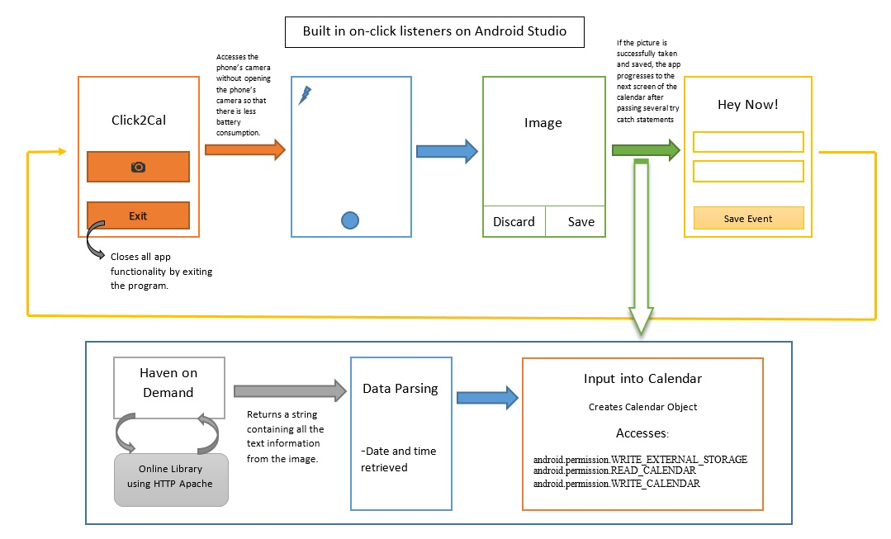
Architecture

Slide 5

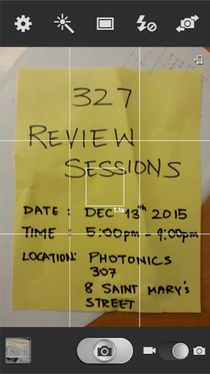
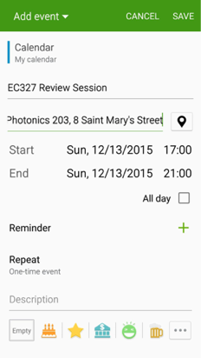
Home Screen
Camera
Calendar
Final Product

Slide 6

Front End
Permissions for Camera
Overrides the settings to get permissions for camera.
Permissions for Calendar
Overrides the settings to get permissions for calendar.
Home Screen :
Designed and developed using Java and .xml.
Logo:
Designed using Adobe Photoshop

Slide 7

Back End
Haven OCR
Regex

Slide 8
HAVEN’s OCR
What is Haven?
Haven OnDemand OCR is an Optical Content Recognition software that extracts text along with about the location of the detected text in the original image. The API returns the extracted text and information about the location of the detected text in the original image without the layout.
How is it implemented
To access the API, we need to add an API key and call the API. The API itself uses an online library with HTTP Apache to convert the image to text. The output of the OCR is a JSON Object

Slide 9
HAVEN’s OCR
The 4 types of image modes:
document_photo: This default mode that uses image that has been captured with variable light, usually with mobile phone camera.
document_scan: This mode is used for images that have been captured under constant lighting, usually with flat scanner.
scene_photo: This mode is used to capture images from a scene as signs and billboards.
subtitle: This mode is used to capture images with superimposed subtitles as found in TV subtitles

Slide 10
Regular Expressions
What are regular expressions?
Regular expressions are the standard language for parsing text and searching. To use it in Java, we had to import libraries such as:
java.util.ArrayList
java.util.List
java.util.regex.*
java.io.*

Slide 11
Regular Expressions
How is it implemented?
Using regex, we searched for patterns for the date and time using Pattern class and Matcher class, which are inbuilt in regex.
We then compared the text to the keywords to find the matching month, day and year of the event.
Case insensitive feature added
Options considered:
December 12th, 2015
Dec 12th, 2015
12/12/2015
11:00am
11am
noon
5:39pm

Slide 12

Thanks for watching!

